Slide 1
Decomposing Intergenerational Income Elasticity
The gender-differentiated contribution of human and physical capital transmission in rural Philippines
Leah Bevis & Christopher B. Barrett
Cornell University

Slide 2
Background
Equality of socio-economic opportunity
Intergenerational income transmission
Transition matrices
Intergenerational income elasticity (IGE)
Pathways behind intergenerational mobility
Education transmission (Behrman et al 2001 Economia, Thomas 1996 AER)
Health transmission (Strauss &Thomas 1998 JEL, Eriksson 2005 Oslo University)
Land transfers (Quisumbing 1994 JDE, Estudillo et al 2001 JDS)
Assortative marriage (Black & Devereux 2010 NBER, DeSilva & Bakhtiar 2011 Bard College)
Migration (Quisumbing & McNiven 2009 JDS)
2/17
Notes:
IGE: Early estimates biased by measurement error. True estimates around .4-.6, found pretty much worldwide. IGE likely higher in developing world (Salon 2011)

Slide 3
Questions
Which pathways make up intergenerational income transmission in rural Philippines?
How do these pathways change across gender?
How does migration affect capital transmission or income transmission?
3/17

Slide 4
Conceptual Model
Child income depends on child education , which depends on parent education , parent income , and inherited productivity ( after controlling for ).
(1)
(2)
(3)
(4)
(5)
IGE:
Exclusionary Hypothesis:
Equality Hypotheses:
4/17

Slide 5
Conceptual Model
Include child’s spouse’s education , parent & child health , parent & child landholding , and controls for social norms .
5/17

Slide 6
Estimation
Transmission Equations: Seemingly Unrelated Regression (SUR)
Instrumenting parent income with parent expenditure
Adjusts for measurement error (Naschold & Barrett 2011)
Reasonable if consumption smoothing occurs
6/17

Slide 7
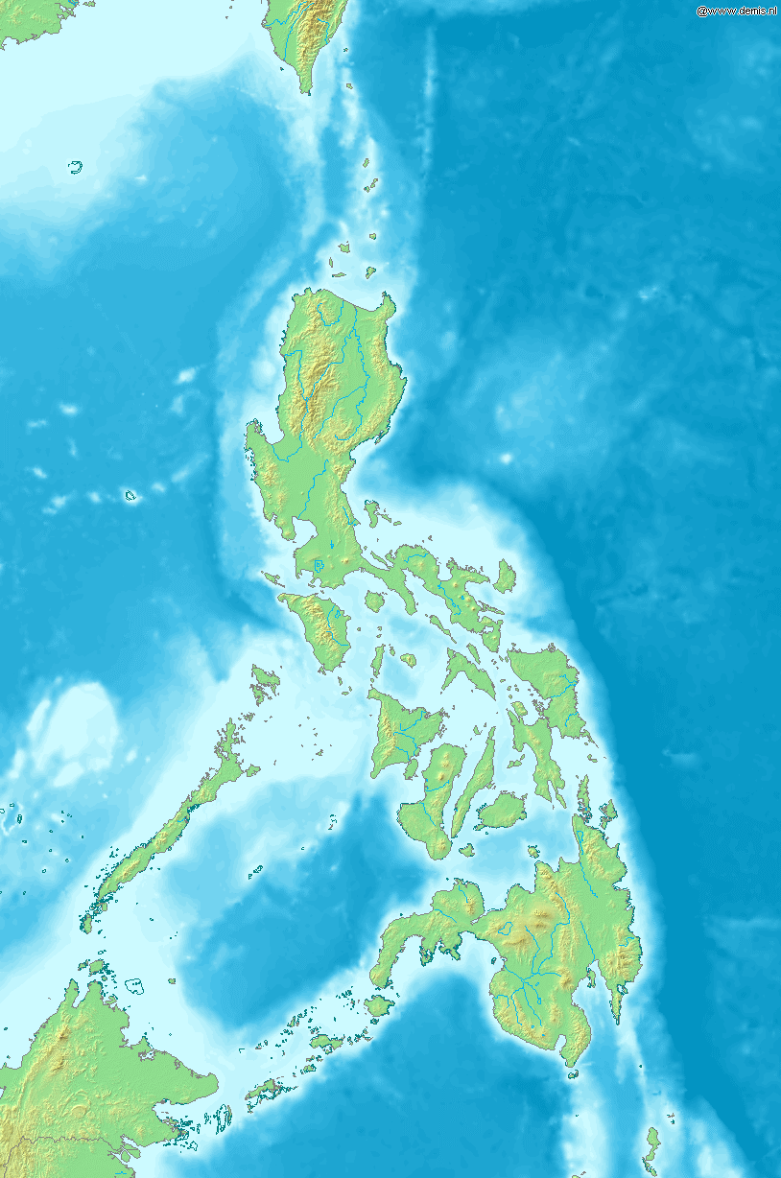
Data
Bukidnon: a rural, landlocked province of southern Philippines
Gathered over two decades:
1984: 448 families relying primarily on agricultural income, largely sugar, corn or rice
2003/2004: revisited original families, tracked children to new homes in local, peri-urban & urban locations
“Split” vs “migrant” children
As children, not significantly different except by gender and birth order.
By adulthood migrants better educated, wealthier
7/17

Slide 8
Data
 | Mean Values Daughters | Mean Values Sons | Mean Values Migrants | Mean Values Non-Migrants
Child Age (years) ‘84 | 9.6 | 10.4 | 9.5 | 10.3
Father Age (years) ‘84 | 40 | 40 | 40 | 40
Mother’s Education (years) ‘84 | 5.9 | 5.6 | 5.9 | 5.6
Father’s Height (years) ’84 | 161 | 161 | 161 | 161
Parent Landholdings (hectares) ‘84 | 2.3 | 2.6 | 2.6 | 2.3
Parent Weekly Income (Philippine Peso) ‘84 | 270 | 301 | 288 | 279
Child Age (years) ‘03 | 29 | 30 | 29 | 29
Child Household Size (persons) ‘03 | 7.0 | 7.2 | 4.6 | 5.3
Child Education (years) ‘03 | 9.7 | 8.6 | 9.8 | 8.8
Spouse Education (years) ‘03 | 9.3 | 10.1 | 10.2 | 9.1
Child Height (cm) ‘03 | 150 | 163 | 155 | 156
Child Landholdings (hectares) ‘03 | 0.1 | 0.3 | 0.2 | 0.2
Child Weekly Income (Philippine Peso) ‘03 | 1830 | 1805 | 2439 | 1326
8/17

Slide 9
IGE Decomposition: Parent Capital Pathways
(NOT Controlling for Child Capital)
 | (1) | (2) | (3) | (4)
 | Daughters | Sons | Migrants | Non-Migrants
Log Parent Income ‘84 | 0.919*** | -0.306 | 1.092** | 0.524**
 | (0.290) | (0.389) | (0.533) | (0.212)
Parent Land ‘84 | -0.00935 | 0.0637** | -0.0551 | 0.0138
 | (0.0195) | (0.0318) | (0.0461) | (0.0168)
Mother’s Education | 0.0507* | 0.0588 | 0.0802 | 0.0269
 | (0.0307) | (0.0395) | (0.0571) | (0.0358)
Father’s Education | -0.00712 | 0.0676 | -0.0866 | 0.0156
 | (0.0300) | (0.0431) | (0.0608) | (0.0288)
Mother’s Height | 0.0130 | -0.0425** | 0.00110 | -0.00290
 | (0.0117) | (0.0168) | (0.0196) | (0.0115)
Father’s Height | -0.00604 | -0.0217 | -0.0184 | -0.0160
 | (0.0136) | (0.0160) | (0.0220) | (0.0101)
Observations | 236 | 179 | 182 | 235
R-squared | 0.360 | 0.434 | 0.238 | 0.358
Controls include household size, gender-specific birth order dummies, location & ethnic groups
9/17

Slide 10
Parent Liquidity & Productivity Transmission
 | (1) IGE | (2) IGE w/ Controls | (3) Parent Income | (4) Productivity
Daughters | 0.534*** | 1.042*** | 0.919*** | 0.721**
 | (0.162) | (0.280) | (0.290) | (0.320)
 | 0.115 | 0.329 | 0.360 | 0.428
Sons | 0.429*** | 0.184 | -0.306 | -0.272
 | (0.147) | (0.257) | (0.389) | (0.364)
 | 0.050 | 0.350 | 0.434 | 0.593
Migrants | 0.567*** | 0.831*** | 1.092** | 0.456
 | (0.195) | (0.322) | (0.533) | (0.546)
 | 0.048 | 0.285 | 0.238 | 0.515
Non-Migrants | 0.474*** | 0.651*** | 0.524** | 0.527**
 | (0.103) | (0.160) | (0.212) | (0.207)
 | 0.122 | 0.320 | 0.358 | 0.434
Age Controls: | Yes | Yes | Yes | Yes
Additional Controls: | No | Yes | Yes | Yes
Parent Capital: | No | No | Yes | Yes
Child Capital: | No | No | No | Yes
10/17

Slide 11
Conclusions
Son IGE is explained by capital transmission; daughter IGE is explained by liquidity & productivity transmission
While parent income does not affect most child capital levels, son & son-in-law education are normal goods
Daughter income strongly influenced by marriage market, parent liquidity & productivity transmission
Parent liquidity influences migrant income more than it does non-migrant income; productivity transmission is high for non-migrants and variable for migrants.
11/17

Slide 12
Extra Slides

Slide 13
Capital Transmission: Daughters
 | (1) | (2) | (3) | (4)
 | Education | Height | Landholdings | Spouse Education
Log Parent Income ‘84 | 0.950 | 1.925 | -0.0184 | 1.554*
 | (0.766) | (3.084) | (0.128) | (0.872)
Parent Land ‘84/’03 | 0.140* | -0.209 | 0.0434*** | 0.000371
 | (0.0814) | (0.331) | (0.0125) | (0.0842)
Mother’s Education | 0.343*** | -0.762** | -0.0137 | 0.189*
 | (0.0798) | (0.317) | (0.0166) | (0.114)
Father’s Education | 0.170** | 0.397 | 0.0157 | 0.252**
 | (0.0830) | (0.330) | (0.0171) | (0.118)
Mother’s Height | -0.0874*** | 0.422*** | -0.00874 | -0.00359
 | (0.0333) | (0.132) | (0.00682) | (0.0470)
Father’s Height | 0.0217 | -0.0181 | -0.00896 | 0.00689
 | (0.0305) | (0.121) | (0.00629) | (0.0434)
Observations | 219 | 219 | 219 | 219
R-squared | 0.581 | 0.243 | 0.331 | 0.410
Controls include household size, gender-specific birth order dummies, location & ethnic groups
Parent land is given by ’84 holdings in columns 1 and 2, and ’03 holdings in columns 3 and 4.
10/17

Slide 14
Capital Transmission: Sons
 | (1) | (2) | (3) | (4)
 | Education | Height | Landholdings | Spouse Education
Log Parent Income ‘84 | 3.185*** | -1.013 | -0.763** | 0.653
 | (1.145) | (2.042) | (0.362) | (0.917)
Parent Land ‘84/’03 | -0.0447 | 0.279 | 0.163*** | -0.0283
 | (0.152) | (0.283) | (0.0281) | (0.0671)
Mother’s Education | 0.312** | -0.0500 | 0.0224 | 0.365***
 | (0.145) | (0.240) | (0.0507) | (0.135)
Father’s Education | 0.137 | 0.272 | 0.00142 | 0.0266
 | (0.124) | (0.208) | (0.0432) | (0.114)
Mother’s Height | 0.0176 | 0.403*** | -0.0178 | 0.0266
 | (0.0584) | (0.0971) | (0.0206) | (0.0548)
Father’s Height | -0.00423 | 0.293*** | -0.0378** | 0.00505
 | (0.0444) | (0.0735) | (0.0157) | (0.0419)
Observations | 156 | 156 | 156 | 156
R-squared | 0.393 | 0.459 | 0.351 | 0.346
Controls include household size, gender-specific birth order dummies, location & ethnic groups
Parent land is given by ’84 holdings in columns 1 and 2, and ’03 holdings in columns 3 and 4.
11/17

Slide 15
Returns to Own Capital
(Controlling for Parent Capital)
 | (1) | (2) | (3) | (4)
 | Daughters | Sons | Migrants | Non-Migrants
Own Education | 0.0483 | 0.0276 | 0.0750 | 0.0345
 | (0.0367) | (0.0221) | (0.0474) | (0.0226)
Spouse Education | 0.0387* | 0.130*** | 0.0614* | 0.0718***
 | (0.0199) | (0.0235) | (0.0329) | (0.0176)
Own Height | -0.00524 | 0.0219 | 0.00315 | -0.00200
 | (0.00799) | (0.0141) | (0.00643) | (0.0133)
Landholdings | 0.355*** | 0.130** | 0.108 | 0.222*
 | (0.125) | (0.0550) | (0.101) | (0.118)
Observations | 216 | 154 | 148 | 224
R-squared | 0.428 | 0.593 | 0.515 | 0.434
Controls include household size, gender-specific birth order dummies, location & ethnic groups,
father and mother education, father and mother height, parent landholdings, parent income
13/17

Slide 16
Returns to Parent Capital
(Controlling for Child Capital)
 | (1) | (2) | (3) | (4)
 | Daughters | Sons | Migrants | Non-Migrants
Log Parent Income ‘84 | 0.721** | -0.272 | 0.456 | 0.527**
 | (0.320) | (0.364) | (0.546) | (0.207)
Parent Land ‘84 | -0.0348 | 0.0323 | -0.0447* | -0.0162
 | (0.0229) | (0.0251) | (0.0269) | (0.0199)
Mother’s Education | 0.0670* | 0.0401 | 0.0723* | 0.0178
 | (0.0370) | (0.0383) | (0.0390) | (0.0354)
Father’s Education | -0.0349 | 0.0218 | -0.0845** | 0.00157
 | (0.0298) | (0.0325) | (0.0382) | (0.0263)
Mother’s Height | 0.0312** | -0.0662*** | 0.00877 | -0.00543
 | (0.0122) | (0.0195) | (0.0194) | (0.0126)
Father’s Height | -0.00462 | -0.0289** | -0.0276 | -0.0137
 | (0.0121) | (0.0131) | (0.0200) | (0.0108)
Observations | 216 | 154 | 148 | 224
R-squared | 0.428 | 0.593 | 0.515 | 0.434
Controls include household size, gender-specific birth order dummies, location & ethnic groups,
child and spouse education, child height, child landholdings
14/17

Slide 17
Data
 | Mean Values Daughters | Mean Values Sons
Child Age (years) ‘84 | 9.6 | 10.4
Father Age (years) ‘84 | 40 | 40
Household Size (persons) ‘84 | 7.0 | 7.2
Father’s Education (years) ‘84 | 5.0 | 5.2
Mother’s Education (years) ‘84 | 5.9 | 5.6
Father’s Height (cm) ‘84 | 161 | 161
Mother’s Height (cm) ‘84 | 150 | 150
Parent Landholdings (hectares) ‘84 | 2.3 | 2.6
Parent Weekly Income (Philippine Peso)‘84 | 270 | 301
Mother’s Birth Age (years) ‘84 | 26 | 25
Child Birth Order (number, 1=eldest) ‘84 | 3.0 | 2.7
8/17

Slide 18
Data
 | Mean Values Daughters | Mean Values Sons | Mean Values Migrants | Mean Values Non-Migrants
Child Age (years) ‘03 | 29 | 30 | 29 | 29
Spouse Age (years) ‘03 | 29 | 32 | 32 | 28
Child Household Size (persons) ‘03 | 7.0 | 7.2 | 4.6 | 5.3
Child Education (years) ‘03 | 9.7 | 8.6 | 9.8 | 8.8
Spouse Education (years) ‘03 | 9.3 | 10.1 | 10.2 | 9.1
Child Height (cm) ‘03 | 150 | 163 | 155 | 156
Child Landholdings (hectares) ‘03 | 0.1 | 0.3 | 0.2 | 0.2
Child Weekly Income (Philippine Peso) ‘03 | 1830 | 1805 | 2439 | 1326
9/17

Slide 19
References
Behrman, Jere, Alejandro Gaviria, Miguel Szekely, Nancy Birdsall, Sebastian Galiani. 2001. “Intergenerational mobility in Latin America,” Economia, 2(1):1-44.
DeSilva, Sanjaya, Mohammed Mehrab Bin Bakhtiar. 2011. “Women, schooling and marriage in rural Philippines,” Levy Economics Institute of Bard College, Working Paper No. 701.
Eriksson, Tor, Bernt Bratsberg, Oddbjørn Raaum. 2005. “Earnings persistence across generations: transmission through health?” Memorandum 35/2005, Oslo University, Department of Economics.
Estudillo, Jonna, Agnes Quisumbing, Keijiro Otsuka. 2001b. “Gender differences in land inheritance and schooling investments in the rural Philippines,” Land Economics 77(1):130-143.
Quisumbing, Agnes. 1994. “Intergenerational transmissions in Philippine rice villages gender differences in traditional inheritance customs,” Journal of Development Economics, 43(2):167-197.
Quisumbing, Agnes, Scott McNiven. 2010. “Moving forward, looking back: the impact of migration and remittances on assets, consumption, and credit constraints in the rural Philippines,” Journal of Development Studies, 46(1): 91–113.
Naschold, Felix, Christopher B. Barrett. 2011. “Do short-term observed income changes overstate structural economic mobility?” Oxford Bulletin of Economics and Statistics, 73(5):0305-9049.
Strauss, John, Duncan Thomas. 1998. “Health, nutrition, and economic development, Journal of Economic Literature, 36(2):766-817.
Thomas, Duncan. 1996. “Education across generations in South Africa,” The American Economic Review, 86(2):330-334.
Picture source: http://en.wikipedia.org/wiki/Image:Pana_Banaue_Rice_Terraces.JPG == Summary == Panaramic View Banaue Rice Terraces == Licensing == {{self2|GFDL-with-disclaimers|cc-by-sa-2.5,2.0,1.0}} 17 July 2006 en:User:Niro5
Map source: http://commons.wikimedia.org/wiki/File:Map_of_the_Philippines_Demis.png#filelinks

Slide 20
Conceptual Model
Child Income
Child Land
Child and Spouse Education
Child Productivity
Child Health
Parent Income
Parent Land
Parent Education
Parent Productivity
Parent Health

